Slide 1
STD.12 CH-3 Electrochemistry chapter (2)
Some important points about electrochemical cell

Slide 2
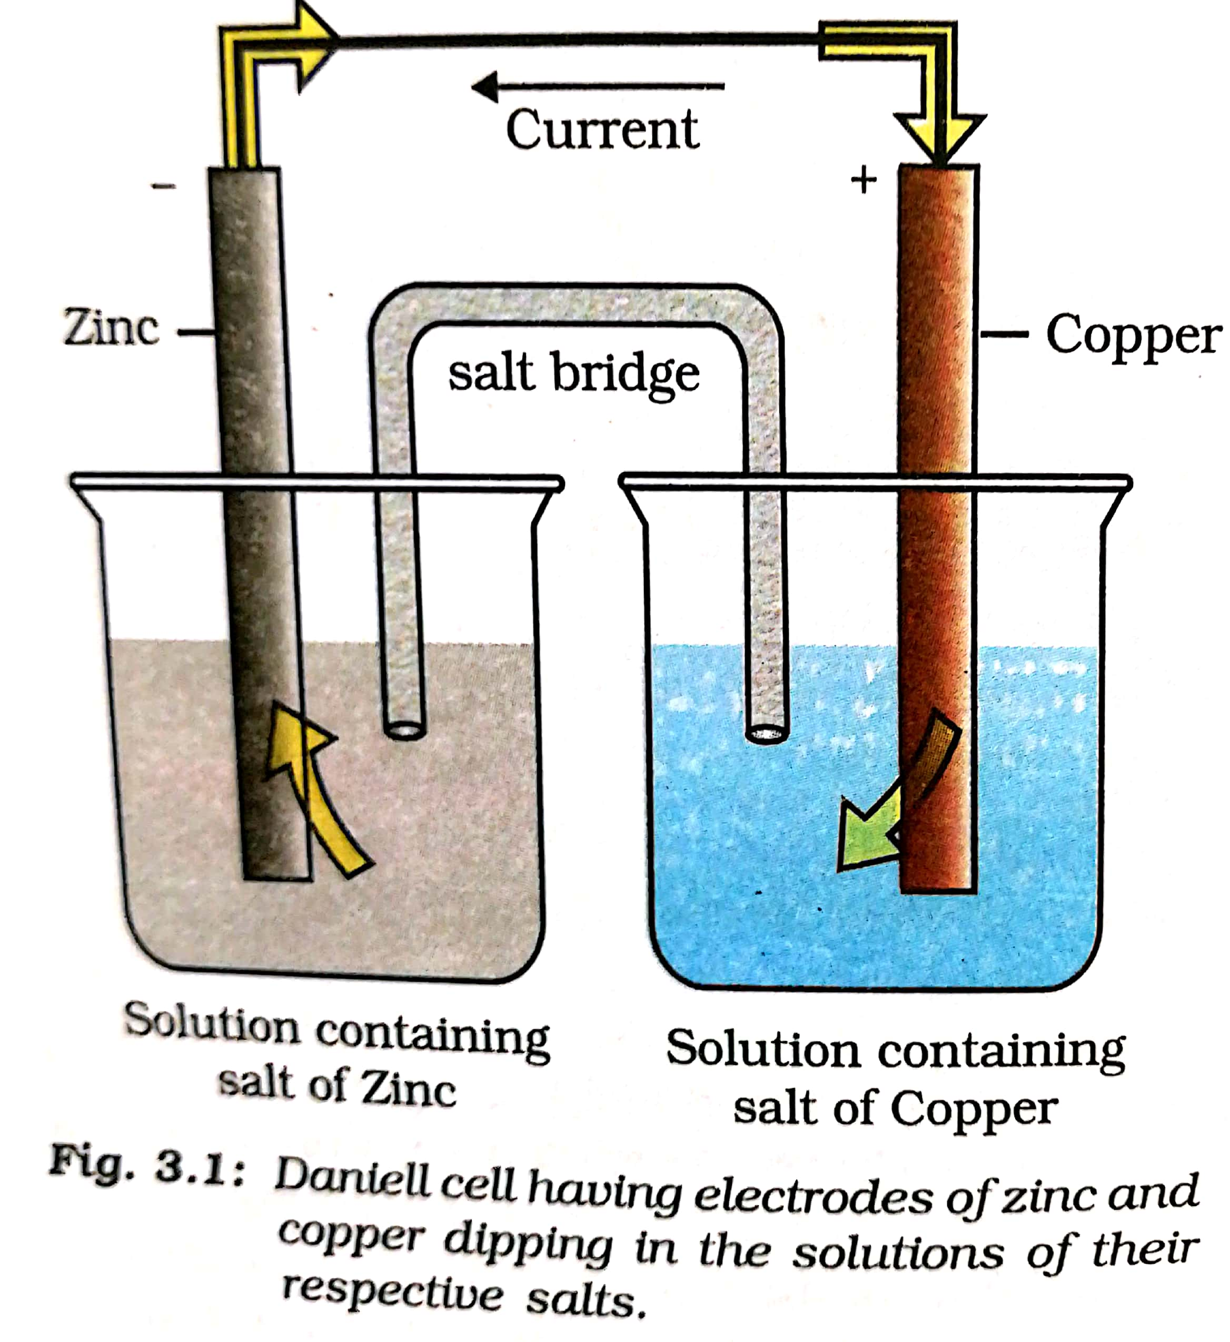

Slide 3
If an external opposite potential is applied in the Galvanic cell and increased slowly we will find that the reaction continues to take place till the opposite voltage reaches the value 1.1 volt.

Slide 4
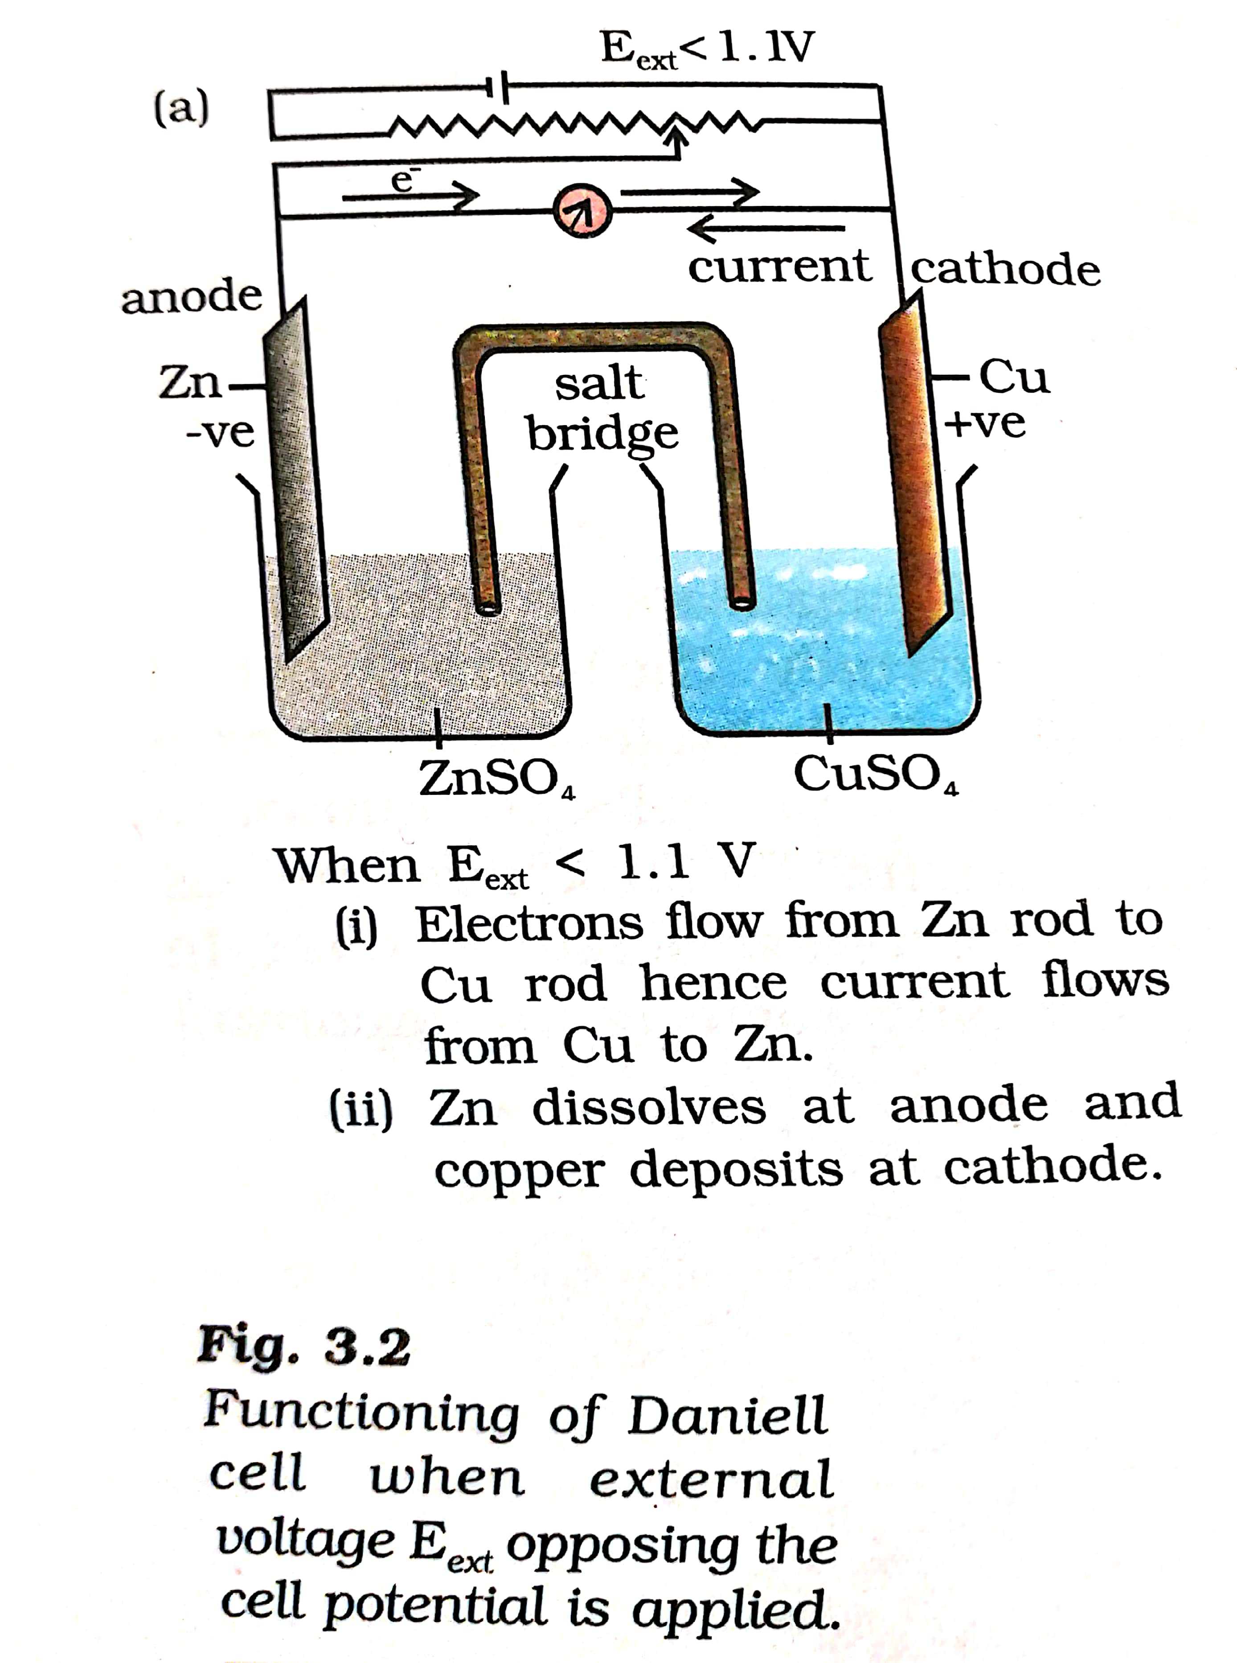

Slide 5
2. At 1.1 volt the reaction will stop
If external potential again increase the reaction start But in opposite directions.

Slide 6
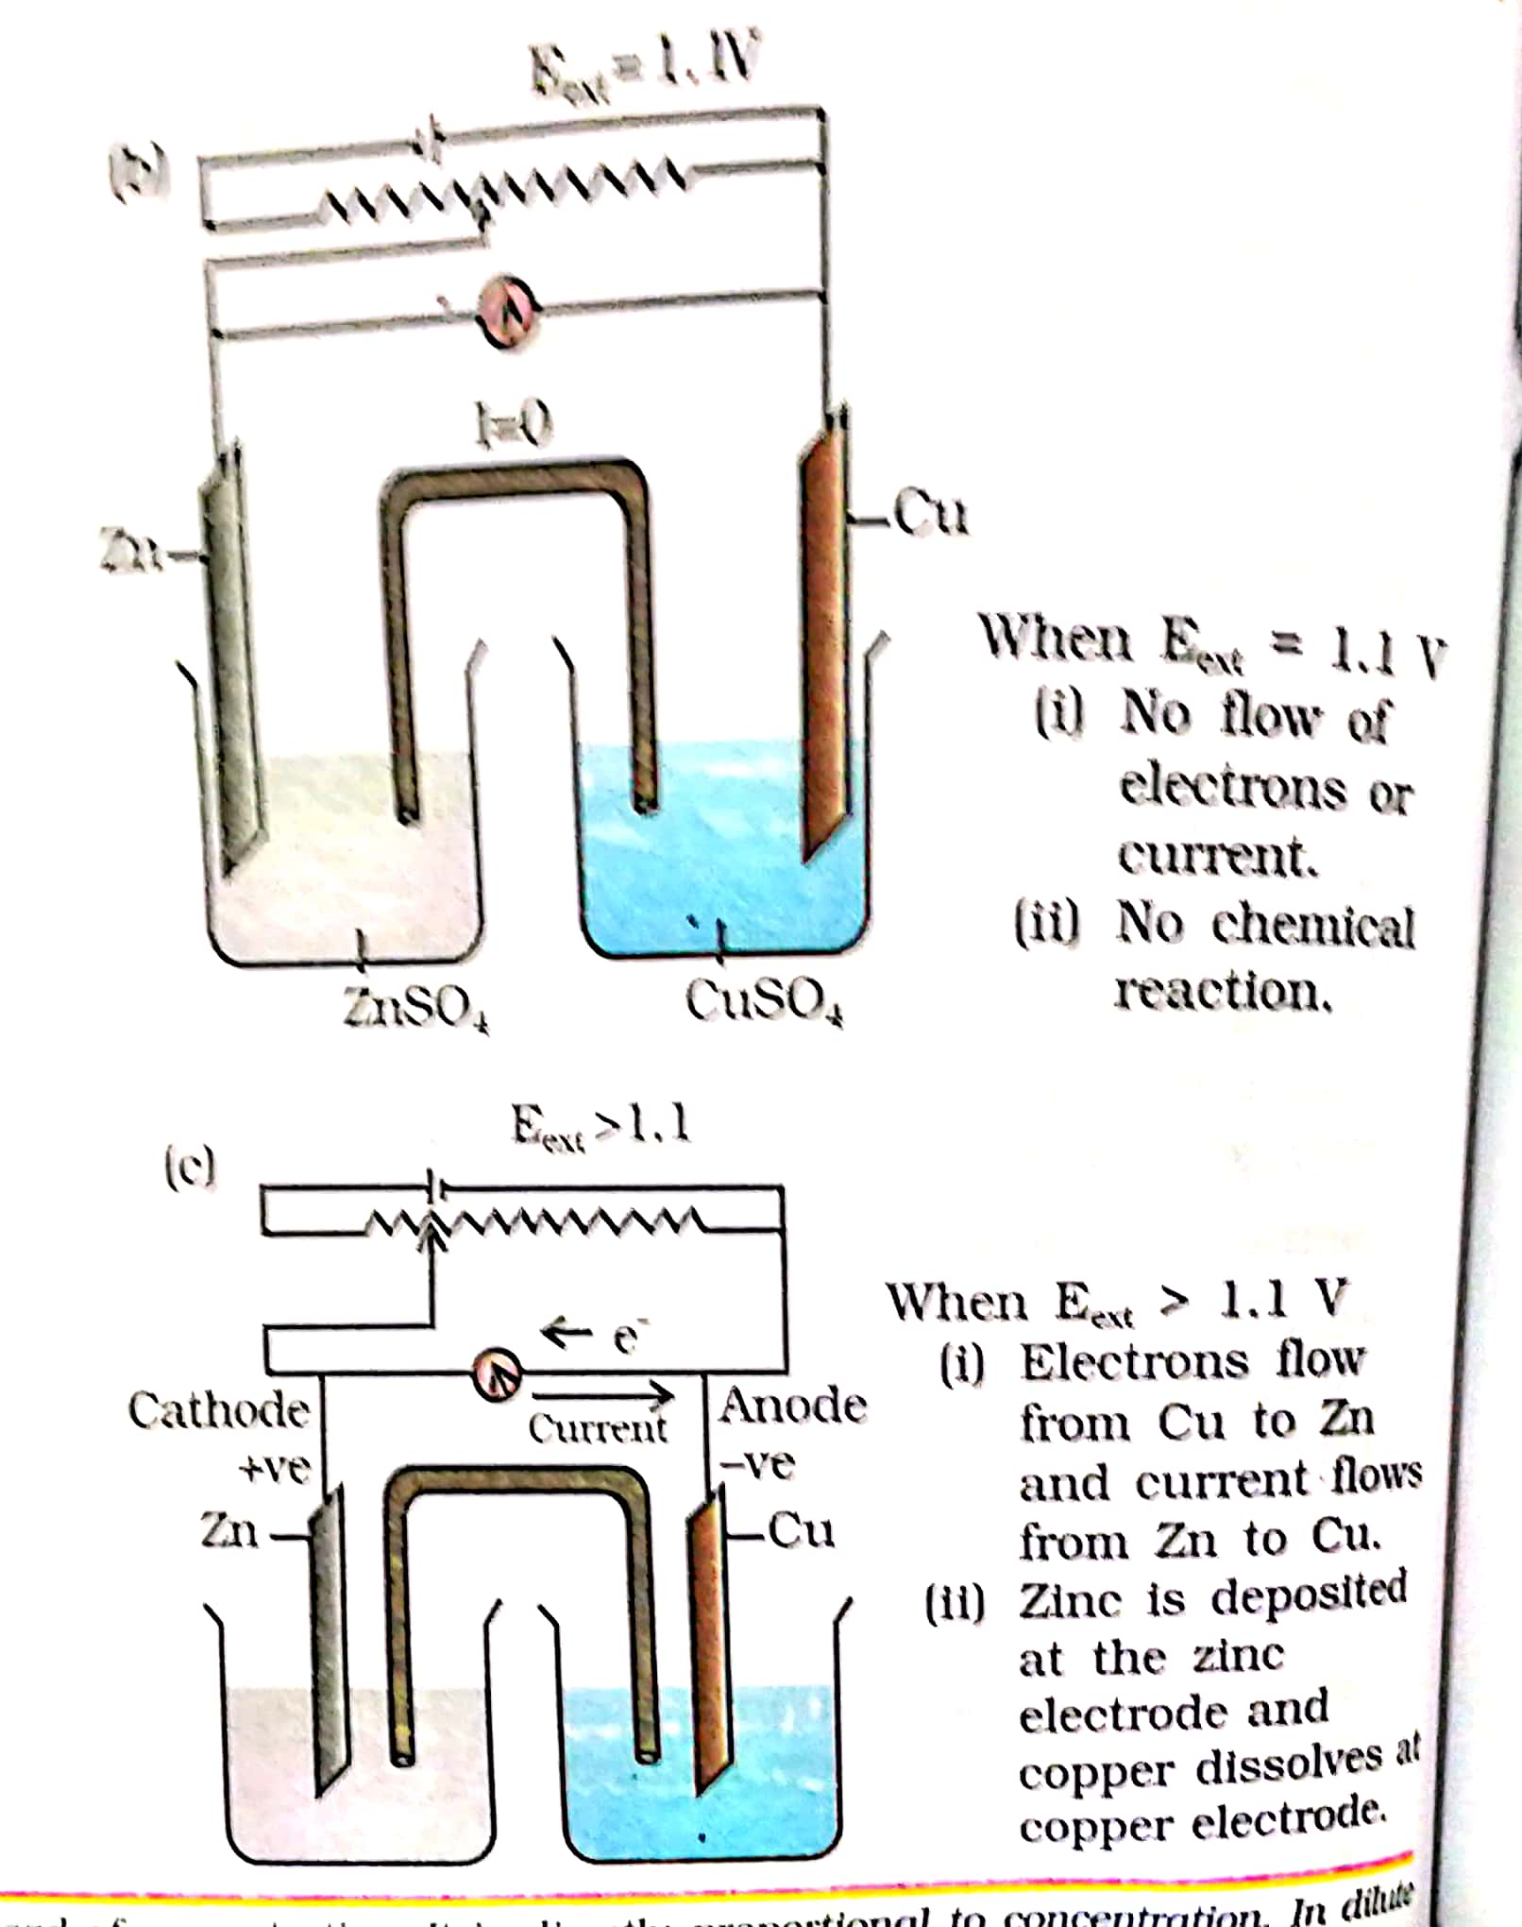

Slide 7
3.The set is now functions as an electrolytic cell.
4.The electrical energy utilized to carry non-spontaneous chemical reactions spontaneous.

Slide 8
THANK YOU

